Slide 1
BAS 475
Time Series

Slide 2
What is Time Series?
A sequence of data points that occur in successive order over some period of time.

Slide 3
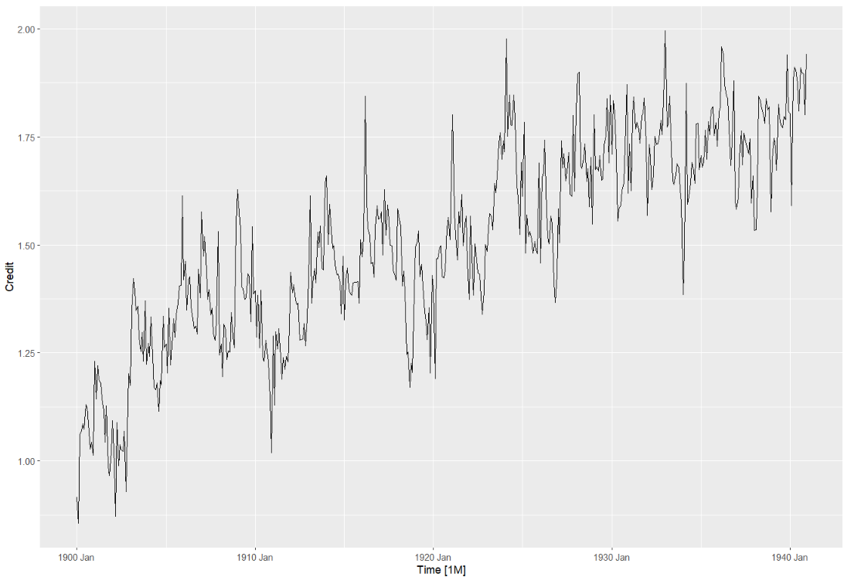
This time series graph demonstrates the amount of credits (in millions) collect by the Imperial Empire each month from 1900 to 1940

Slide 4
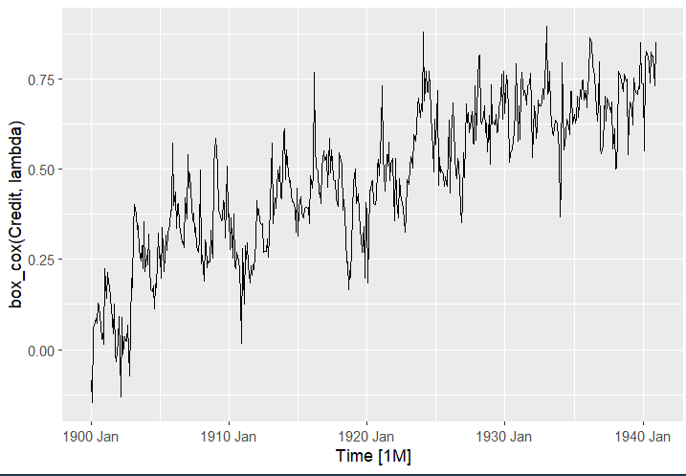
1st Transformation
We transformed the original data using Box_cox to remove noise for a better the results in forecasting this time series.
Noise are
No drastic change from the transformation shown in this graph compare to pr

Slide 5
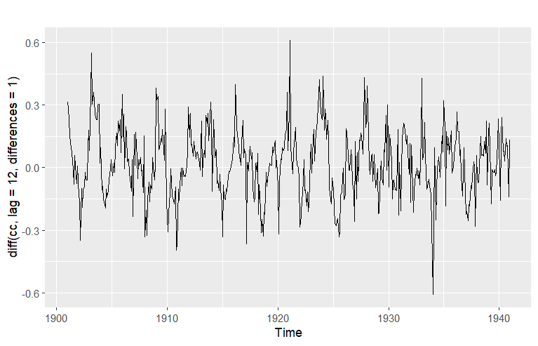
This is the difference between every 12 data points.
Also known as the difference in amount of credits collected each year
This is to analyze if there was a trend or seasonality with the data collected

Slide 6
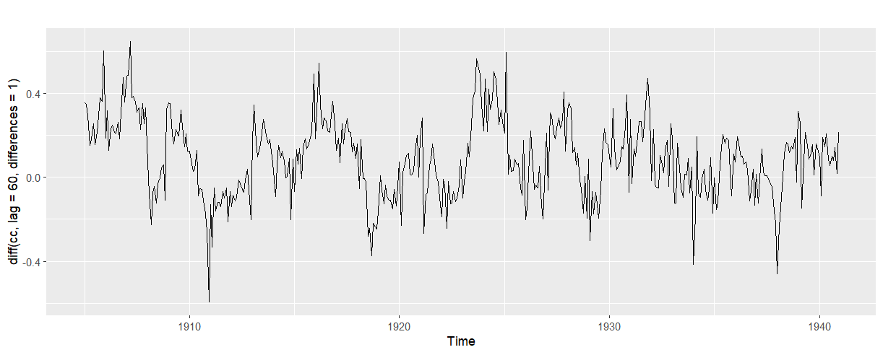
This is the difference in amount of credits collected between every 5 years
As you can see, it’s pretty linear across the graph, hard to see the pattern of trend or seasonality.

Slide 7
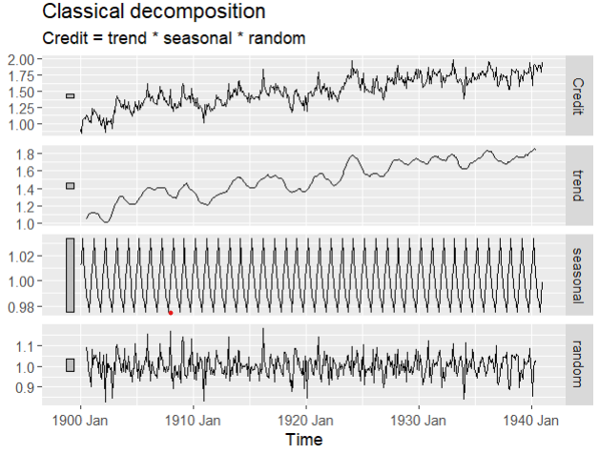
the main objectives for a decomposition is to estimate seasonal effects that can be used to create and present seasonally adjusted values.
A better way to analyze for trends and wayy less time consuming.
DECOMPOSITION OF DATA
TREND shown sign of credits increase over time
RANDOM is shown to be the pattern of this data as well and not seasonal

Slide 8
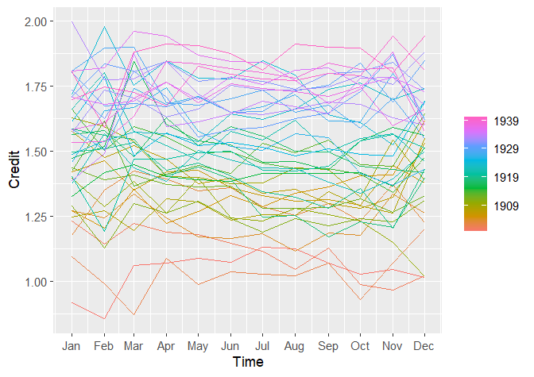
No sign of seasonality of the data collected shown here
(again)

Slide 9
What is Cross Validation?
a resampling method that uses different portions of the data to test and train a model on different iterations.
**This saves us a major time, from calculation the accuracy of all the models we want to test for the forecasting

Slide 10
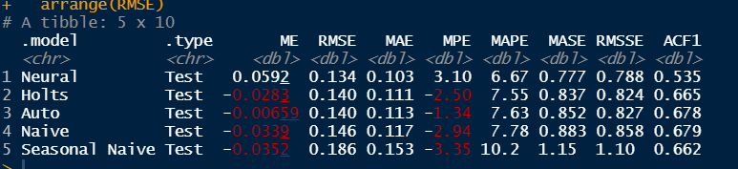
Cross Validation of 5 test models
We cross validate 5 models (Naive, Seasonal Naive, Holts, Auto, Neural) through R Studio.
Neural is our best model, seen here as the model with the lowest RMSE.

Slide 11
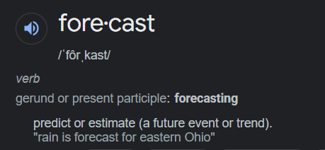
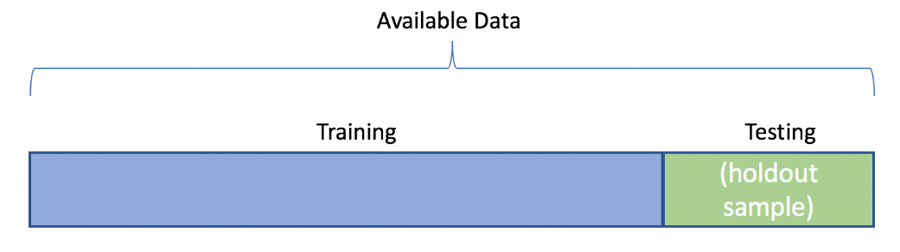
What is Forecasting?
a technique that uses historical data as inputs to make informed estimates that are predictive in determining the direction of future trends
To forecast, we often split our data into 2 parts. Training data and Hold Out data

Slide 12
SPLITTING DATA FOR FORECASTING
(CREDIT DATA)
(CREDIT DATA FROM 1900 JAN TO 1938 JUN)
(REST OF CREDIT DATA AFTER JULY 1938)

Slide 13
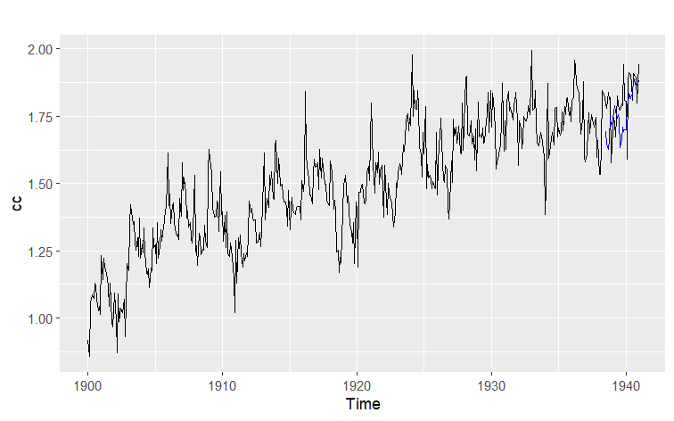
Forecasting of the best model
TRAINING DATA
Using Neural model, the blue line is our forecasted values using the Training data.
HOLD OUT DATA

Slide 14
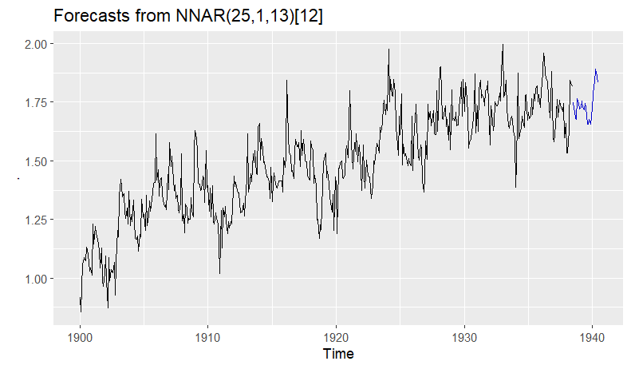
SAME GRAPH AS BEFORE, BUT WITHOUT HOLDOUT DATA FOR A BETTER VISUAL OF THE FORECASTED VALUES

Slide 15
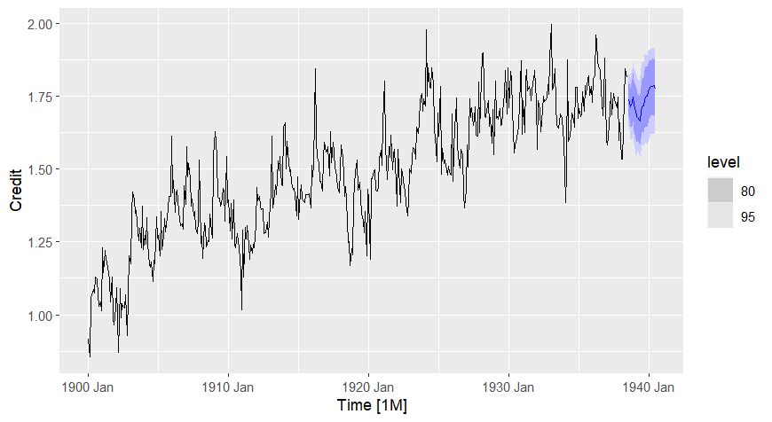
Forecasting of the best model
This image of our forecast for the next twelve months shows the prediction intervals
TRAINING DATA
Prediction intervals display a range of likely values for the forecasted period

Slide 16
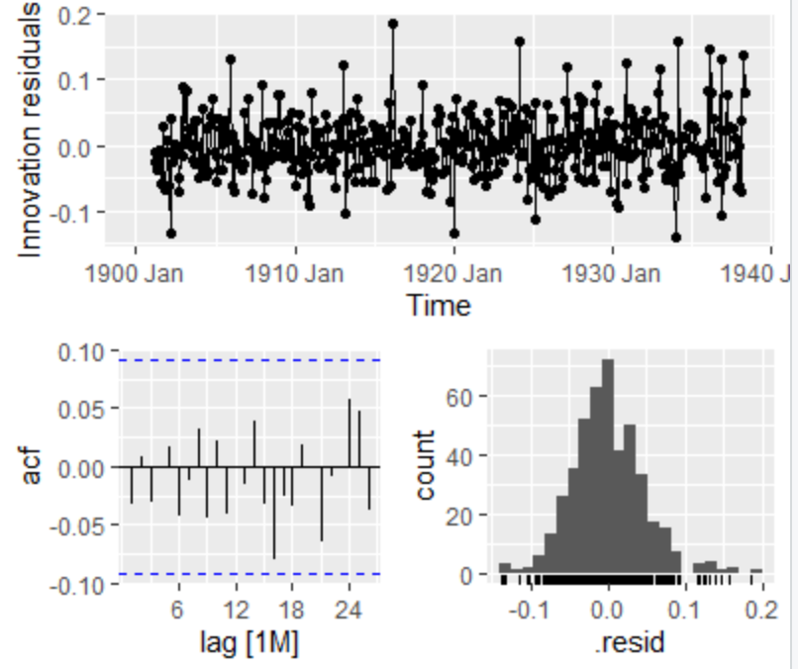
Residuals Analysis of
Best Model: Neural Net
Predicted outcome values - true values
we want to see on the residual graph for any specific we needed to change our data to a more accurate forecasting
Centered around 0 and little heteroskedasticity
No extreme points in ACF graph

Slide 17
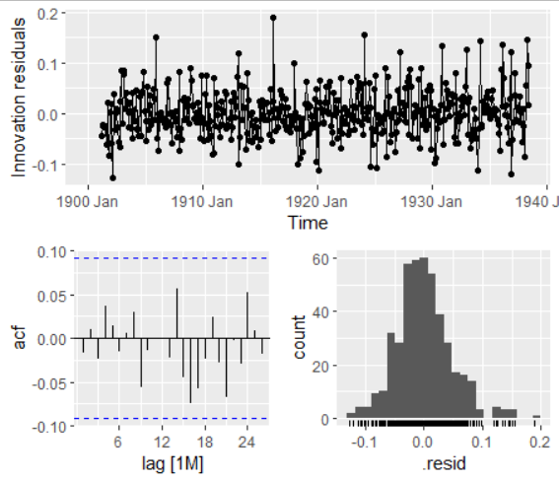
ACF
Autocorrelation Function takes into consideration of all the past observations irrespective of its effect on the future or present time period.
The blue dash lines are the 95% interval

Slide 18
Calculate Accuracy with RMSE/MAPE
RMSE (Root mean squared error)
MAPE (Mean absolute percentage error)
Taking the differences between predicted values from the forecast and the actual values of the data
a relative error measure that uses absolute values to keep the positive and negative errors from canceling one another out and uses relative errors to enable you to compare forecast accuracy between time-series models.
RMSE: 0.1081629
MAPE: 0.05140547
Our results

